Slide 1
Analysis & Design Implementation & Automation Reporting
Software QA Exercise

Slide 2

Contents
Requirements
Test plan
Test specification
Test automation
Test reporting
Software Testing, Verification and Validation

Slide 3
1. Requirements

Slide 4
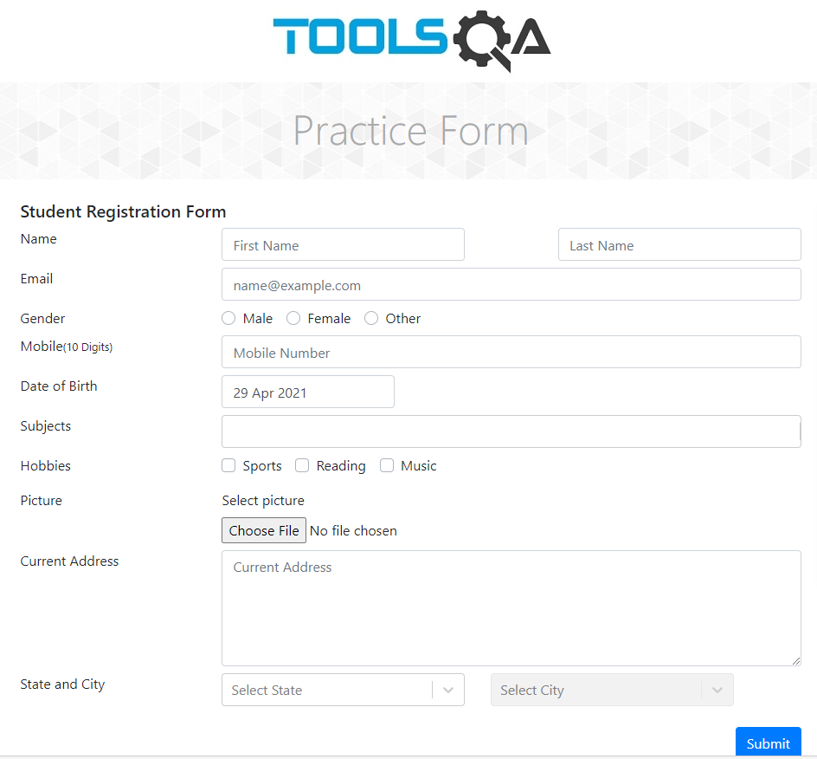
1. Requirements
The intended solution is a on-line student registration form.
User has registration form in which he can submit his information to enrol in a course.
https://demoqa.com/automation-practice-form
Software Testing, Verification and Validation

Slide 5
1. Requirements
High Level Requirements
ID | Description
RF.01 | User must be able to submit his registration.
Software Testing, Verification and Validation

Slide 6
1. Requirements
Low Level Requirements
HL Req. | ID | Title
RF.01 | RF.01.01 | User registration
Software Testing, Verification and Validation

Slide 7
1. Requirements
Low Level Requirements Details
RF.01.01 | User registration
Description | As a user I want to provide my first name, last name, email, gender, mobile phone, date of birth, subjects, hobbies, picture and full address So that I can submit my registration.
Acceptance criteria | Scenario 1 Given: I provide correct information for all the form fields When: I enter them in the registration form Then: I have a successful registration Scenario 2 Given: I provide valid information for all the form fields except for an invalid email When: I enter them in the registration form Then: I have an error in my email input field and an unsuccessful registration Scenario 3 Given: I provide valid information for all the form fields except for an invalid date of birth When: I enter them in the registration form Then: I have an error in my date of birth input field and an unsuccessful registration
Priority | 1
Dependencies

Slide 8
2. Test Plan

Slide 9
2. Test Plan
Req. ID | Requirement Title | Test ID | Test Title | Priority
RF.01.01 | User registration | AT - 001 | Successful Registration | 1
RF.01.01 | User registration | AT – 002 | Successful Registration with three hobbies and three subjects | 2
RF.01.01 | User registration | AT – 003 | Successful Registration with mandatory fields only | 2
RF.01.01 | User registration | AT – 004 | Unsuccessful Registration due to invalid email | 1
RF.01.01 | User registration | AT – 005 | Unsuccessful Registration due to invalid Date of Birth | 1
Software Testing, Verification and Validation

Slide 10
2. Test Plan
Traceability Matrix
Requirements | # Req Tested | RF.01.01
Test Cases
AT – 001 |  | X
AT - 002 |  | X
AT – 003 |  | X
AT – 004 |  | X
AT – 005 |  | X
Software Testing, Verification and Validation

Slide 11
3. Test Specification

Slide 12
3. Test Specification
Requirement ID | RF.01.01
Requirement Title | User registration
Test ID | AT - 001
Description | I insert right first name, last name, email, gender, mobile phone, date of birth, subjects, hobbies, picture and full address
Pre-condition | The Practice form must be available in https://demoqa.com/automation-practice-form

Slide 13
3. Test Specification
Step | Action performed | Data | Expected Result
1 | I insert ${first name} in the first name textbox | ${first name} = João | The ${first name} is visible in textbox
2 | I insert ${last name} in the last name textbox | ${last name} = Santos | The ${last name} is visible in textbox
3 | I insert ${email} in the email textbox | ${email}= joao@example.com | The ${email} is visible in textbox
4 | I select ${gender} in the gender radio button | ${gender} = Male | The ${gender} stay marked
5 | I insert ${mobile phone} in the mobile phone textbox | ${mobile phone}= 1234567890 | The ${mobile phone} is visible in textbox
6 | I insert ${date of birth} in the date of birth textbox | ${date of birth} = 20 April 1980 | The ${date of birth} is visible in textbox
7 | I select ${subjects} in the subjects textbox | ${subjects} = Arts | The ${subjects} is visible in textbox
8 | I select one ${hobbies} in the hobbies checkbox | ${hobbies} = Sports | The ${hobbies} stay marked
9 | I click in the Choose File button and selected ${picture} | ${button} = Choose File ${picture} = Wallpaper.jpg ${Layer} = No file chosen | The text of the ${Layer} is changed for ${picture}
10 | I insert ${Current address} } in the Current address textbox | ${Current address} = Avenue, 1 | The ${Current address} is visible in textbox
11 | I select ${state} in the state combobox | ${state} = NCR | The ${state} stays selected The ${city} showing options relative to the state selected
12 | I select ${city} in the city combobox | ${city} = NOIDA | The ${city} stays selected
13 | I click in the Submit button. I validate the success message. | ${message} = Thanks for submitting the form ${first name} = João ${last name} = Santos ${mobile phone}= 1234567890 ${Current address} = Avenue, 1 | Success ${message} and Dialog shown with my data. The Close button is active

Slide 14
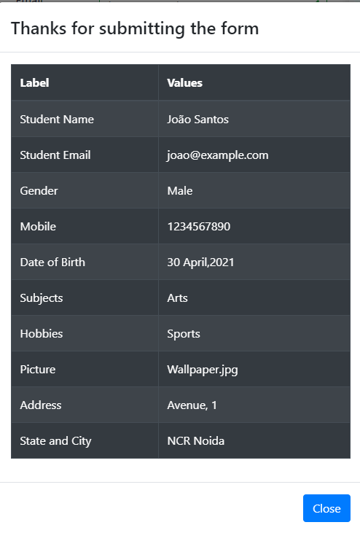

Slide 15
3. Test Specification
Requirement ID | RF.01.01
Requirement Title | User registration
Test ID | AT - 002
Description | I insert right first name, last name, email, gender, mobile phone, date of birth, subjects, hobbies, picture and full address
Pre-condition | The Practice form must be available in https://demoqa.com/automation-practice-form

Slide 16
3. Test Specification
Step | Action performed | Data | Expected Result
1 | I insert ${first name} in the first name textbox | ${first name} = Maria | The ${first name} is visible in textbox
2 | I insert ${last name} in the last name textbox | ${last name} = Santos | The ${last name} is visible in textbox
3 | I insert ${email} in the email textbox | ${email}= maria@example.com.pt | The ${email} is visible in textbox
4 | I select ${gender} in the gender radio button | ${gender} = Female | The ${gender} stay marked
5 | I insert ${mobile phone} in the mobile phone textbox | ${mobile phone}= 0000000000 | The ${mobile phone} is visible in textbox
6 | I insert ${date of birth} in the date of birth textbox | ${date of birth} = 20 April 1980 | The ${date of birth} is visible in textbox
7 | I select ${subjects} in the subjects textbox | ${subjects} = Biology, Hindi, Maths | The ${subjects} is visible in textbox
8 | I select all ${hobbies} in the hobbies checkbox | ${hobbies} = Sports, Reading, Music | The ${hobbies} stay marked
9 | I click in the ${button} and selected ${picture} | ${button} = Choose File ${picture} = Wallpaper.jpg ${Layer} = No file chosen | The text of the ${Layer} is changed for ${picture}
10 | I insert ${Current address} } in the Current address textbox | ${Current address} = Avenue, 1 | The ${Current address} is visible in textbox
11 | I select ${state} in the state combobox | ${state} = Rajasthan | The ${state} stays selected The ${city} showing options relative to the state selected
12 | I select ${city} in the city combobox | ${city} = Jaipur | The ${city} stays selected
13 | I click in the Submit button. I validate the success message. | ${message} = Thanks for submitting the form | Success ${message} and Dialog shown with my data. The Close button is active

Slide 17
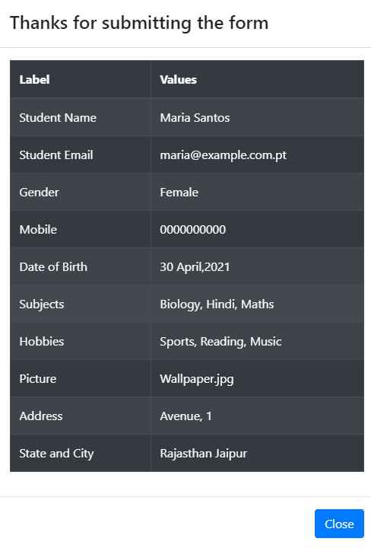

Slide 18
3. Test Specification
Requirement ID | RF.01.01
Requirement Title | User registration
Test ID | AT - 003
Description | I insert right first name, last name, gender and mobile phone
Pre-condition | The Practice form must be available in https://demoqa.com/automation-practice-form

Slide 19
3. Test Specification
Step | Action performed | Data | Expected Result
1 | I insert ${first name} in the first name textbox | ${first name} = S | The ${first name} is visible in textbox
2 | I insert ${last name} in the last name textbox | ${last name} = S | The ${last name} is visible in textbox
4 | I select ${gender} in the gender radio button | ${gender} = Other | The ${gender} stay marked
5 | I insert ${mobile phone} in the mobile phone textbox | ${mobile phone}= 9876543210 | The ${mobile phone} is visible in textbox
13 | I click in the Submit button. I validate the success message. | ${message} = Thanks for submitting the form | Success ${message} and Dialog shown with my data and Date of Birth Default The Close button is active

Slide 20
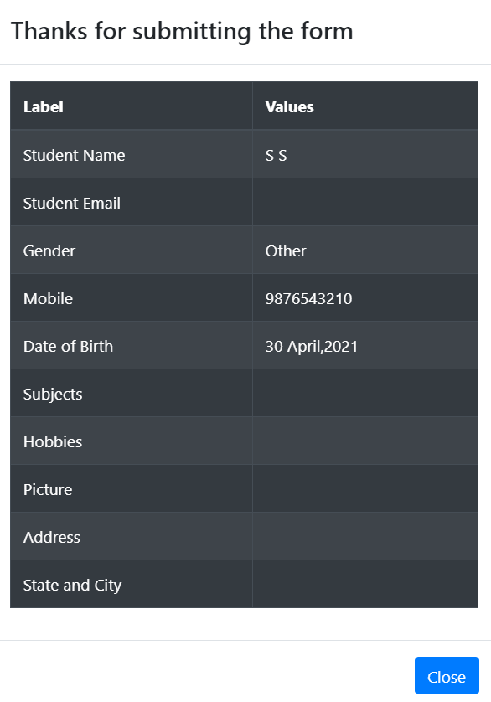

Slide 21
3. Test Specification
Requirement ID | RF.01.01
Requirement Title | User registration
Test ID | AT- 004
Description | I insert right first name, last name, gender, mobile phone, date of birth, subjects, hobbies, picture, full address and invalid email
Pre-condition | The Practice form must be available in https://demoqa.com/automation-practice-form

Slide 22
3. Test Specification
Step | Action performed | Data | Expected Result
1 | I insert ${first name} in the first name textbox | ${first name} = João | The ${first name} is visible in textbox
2 | I insert ${last name} in the last name textbox | ${last name} = Santos | The ${last name} is visible in textbox
3 | I insert ${email} in the email textbox | ${email}= @example.com | The ${email} is visible in textbox
4 | I select ${gender} in the gender radio button | ${gender} = Male | The ${gender} stay marked
5 | I insert ${mobile phone} in the mobile phone textbox | ${mobile phone}= 1234567890 | The ${mobile phone} is visible in textbox
6 | I insert ${date of birth} in the date of birth textbox | ${date of birth} = 20 April 1980 | The ${date of birth} is visible in textbox
7 | I insert ${subjects} in the subjects textbox | ${subjects} = Math | The ${subjects} is visible in textbox
8 | I select one ${hobbies} in the hobbies checkbox | ${hobbies} = Music | The ${hobbies} stay marked
9 | I click in the ${button} and selected ${picture} | ${button} = Choose File ${picture} = Wallpaper.jpg ${Layer} = No file chosen | The text of the ${Layer} is changed for ${picture}
10 | I insert ${Current address} } in the Current address textbox | ${Current address} = Avenue, 2 | The ${Current address} is visible in textbox
11 | I select ${state} in the state combobox | ${state} = Haryana | The ${state} stays selected The ${city} showing options relative to the state selected
12 | I select ${city} in the city combobox | ${city} = Karnal | The ${city} stays selected
13 | I click in the Submit button. I validate the success message. |  | The email textbox turned red

Slide 23
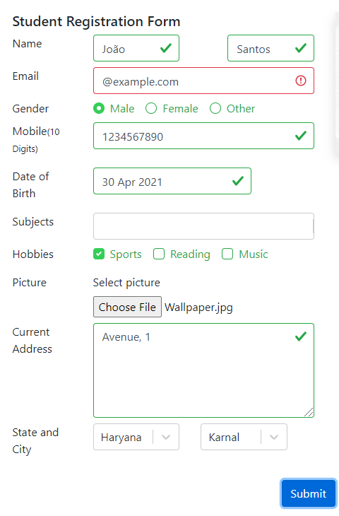

Slide 24
3. Test Specification
Requirement ID | RF.01.01
Requirement Title | User registration
Test ID | AT - 005
Description | I insert right first name, last name, MAIL, gender, mobile phone, subjects, hobbies, picture, full address and invalid date of birth
Pre-condition | The Practice form must be available in https://demoqa.com/automation-practice-form

Slide 25
3. Test Specification
Step | Action performed | Data | Expected Result
1 | I insert ${first name} in the first name textbox | ${first name} = João | The ${first name} is visible in textbox
2 | I insert ${last name} in the last name textbox | ${last name} = Santos | The ${last name} is visible in textbox
3 | I insert ${email} in the email textbox | ${email}= joao@example.com | The ${email} is visible in textbox
4 | I select ${gender} in the gender radio button | ${gender} = Male | The ${gender} stay marked
5 | I insert ${mobile phone} in the mobile phone textbox | ${mobile phone}= 1234567890 | The ${mobile phone} is visible in textbox
6 | I insert ${date of birth} in the date of birth textbox | ${date of birth} = 20 May 2100 | The ${date of birth} is visible in textbox
7 | I insert ${subjects} in the subjects textbox | ${subjects} = Arts | The ${subjects} is visible in textbox
8 | I select one ${hobbies} in the hobbies checkbox | ${hobbies} = Sports | The ${hobbies} stay marked
9 | I click in the ${button} and selected ${picture} | ${button} = Choose File ${picture} = Wallpaper.jpg ${Layer} = No file chosen | The text of the ${Layer} is changed for ${picture}
10 | I insert ${Current address} } in the Current address textbox | ${Current address} = Avenue, 1 | The ${Current address} is visible in textbox
11 | I select ${state} in the state combobox | ${state} = Haryana | The ${state} stays selected The ${city} showing options relative to the state selected
12 | I select ${city} in the city combobox | ${city} = Karnal | The ${city} stays selected
13 | I click in the Submit button. I validate the success message. |  | The date of birth textbox turned red

Slide 26
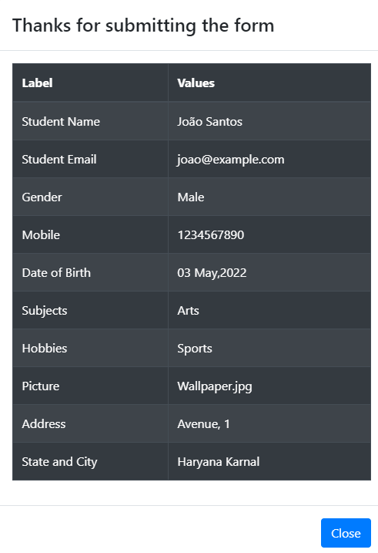

Slide 27
BUG Report
Title: Invalid age is accepted
Priority: High
Description: When entering a future date of birth in relation to the current date, the student record was processed.
Test case: TA – 005
Device/Build:
Google Chrome (Version 90.0.4430.93)
url: https://demoqa.com/automation-practice-form
Expected Result: The date of birth textbox turned red
Actual Result: Success message and Dialog shown with data
Evidences: image to the side

Slide 28
4. Automation

Slide 29
4. Test Automation
Project Repository
Description
Project Structure
Environment Setup
Usage
Common Errors

Slide 30
5. Reporting

Slide 31
5. Test Reporting
Test ID | Test Title | Status
TA – 001 | Successful Registration
TA – 002 | Successful Registration with three all hobbies
TA – 003 | Successful Registration without not mandatory fields
TA – 004 | Unsuccessful Registration due to invalid email
TA – 005 | Unsuccessful Registration due to invalid Date of Birth

Slide 32
5. Test Reporting
Number of tests executed | Pass | Fail
5 | 4 | 1
Para actualizar o gráfico, clicar com botão direito e escolher Edit Data / Editar dados

